Slide 1




Data Mining for Credit Risk Patterns
Giovanna Cardenas

Slide 2
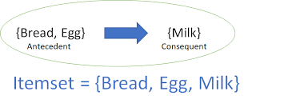
Data Mining Technique used: Association Rule Analysis
Consists of evaluating series of if-then logical statements to find patterns and make predictions.
Support: Proportion of all transactions that an itemset appears in, how often the if-then hypothesis shows up in the dataset
Confidence: Probability of an antecedent leading to the consequent.
Ex: if consumer buys bread and eggs, then they will likely also buy milk.

Slide 3
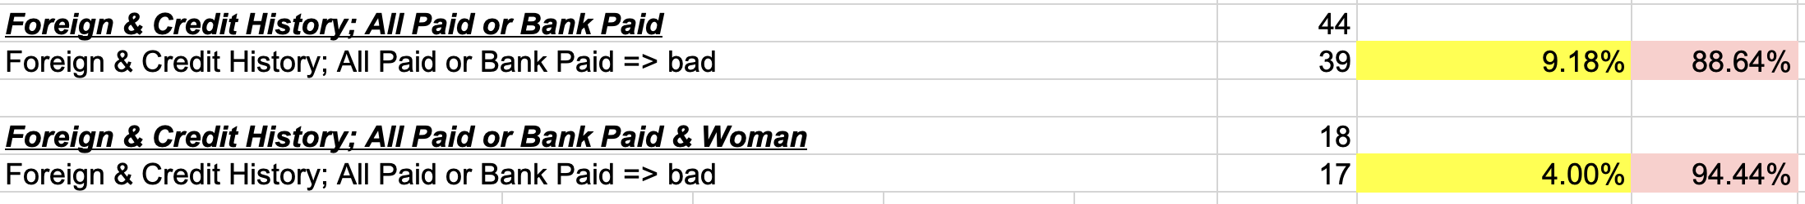
Credit Standing Pattern #1
Clients accounted for: 44/425 = 10.35%
Support: 39/425 = 9.18%
Confidence: 39/44 = 88.64%
But if they are also a woman:
Clients accounted for: 18/425 = 4.24%
Support: 17/425 = 4.00%
Confidence: 17/18 = 94.44%

Slide 4
Credit Standing Pattern #2
Clients accounted for: 96/425 = 22.59%
Support: 81/425 = 19.06%
Confidence: 81/96 = 84.38%

Slide 5
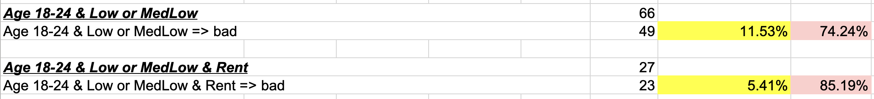
Credit Standing Pattern #2
Clients accounted for: 66/425 = 15.53%
Support: 49/425 = 11.53%
Confidence: 49/66 = 74.24%
But if they also rent:
Clients accounted for: 27/425 = 6.35%
Support: 23/425 = 5.4%
Confidence: 23/27 = 85.18%

Slide 6
Call to Action
Investing in the continuance of Association Rule analysis will allow us to discover hidden patterns within our clientele to help us better understand their circumstances.
Using these patterns, we can implement a system to flag clients as possible business prospects or as possible risks to the company.
This system will not only support the maximization of profits and minimization of costs but will also allow banking loan requests to be accepted or denied faster.
Faster decision making could reduce labor costs and/or allow more time from productivity in other areas.

